Slide 1




CLOUD COMPUTING PERFROMANCE ANALYSIS
Presented By : Akash Singh
Anand Mohan Vyas
Pradyutha Kaushik
Tanmay Jagtap
Manasi Nair

Slide 2







Global Insights on Cloud Energy Utilization

Slide 3




Introduction
The increasing global reliance on cloud computing services has led to a rise in energy consumption in data centers.
This directly contributes to higher carbon emission and impacts operational costs.
This project analyses a dataset that contains performance metrics from a simulated cloud computing environment.

Slide 4
Business Context
Cloud service provider focusing on high-performance infrastructure.
Challenges
High energy consumption.
Inefficient resource use.
Delayed task execution.
Beneficiaries
Businesses relying on efficient, scalable cloud services.

Slide 5

Dataset Overview
Aspect | Details
Dataset Source | Kaggle
Number of Attributes | 12
Key Attributes | VM ID, CPU usage (%), memory usage (%), network traffic (MB), power consumption (W), execution time (s)
Tools Used | Storage Account, Azure Synapse Analytics, Azure Machine Learning
Types of Analytics | Descriptive Analytics: Historical performance insights (CPU, memory, network, energy)
 | Predictive Analytics: Forecast bottlenecks, energy spikes, and resource surges.
 | Prescriptive Analytics: Actionable strategies to optimize performance and reduce costs.

Slide 6
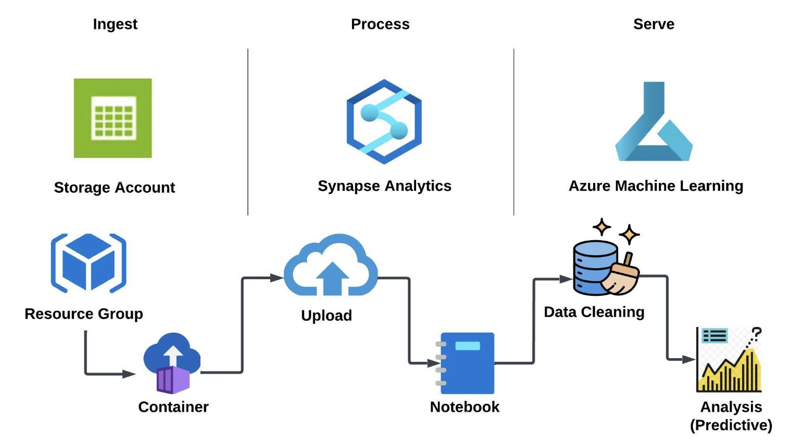
Process Flow

Slide 7

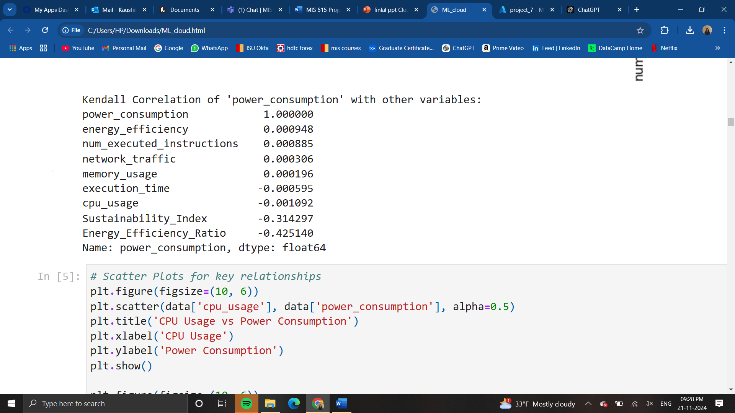
Key Metrics and Focus
Key Metrics:
Network traffic, power consumption, energy efficiency.
01
Derived Metrics:
Energy Efficiency Ratio (EER):
Power consumption ÷ executed instructions.
Sustainability Index (SI): (EER × network traffic) ÷ (power consumption + execution time)
02

Slide 8
Visualizations
Predictive Analysis
Power Consumption Forecast
Time Series Analysis
Prescriptive Analysis
Impact of power consumption on CO2 emission
Renewable energy consumption vs CO2 emission

Slide 9



Model Selection
Linear Regression - Mean R²: 0.19
Decision Tree Regressor - Mean R²: 0.60
Extra Trees Regressor - Mean R²: 0.33
Gradient Boosting Regressor - Mean R²: 0.48
K-Neighbors Regressor (KNN) - Mean R²: 0.35

Slide 10
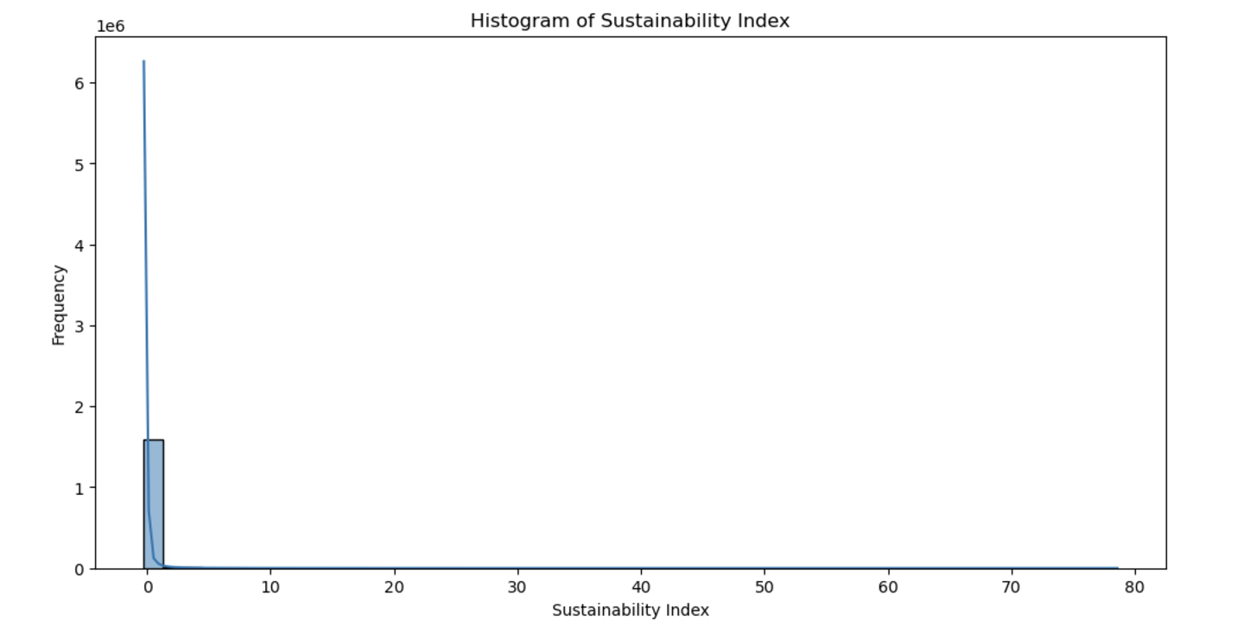
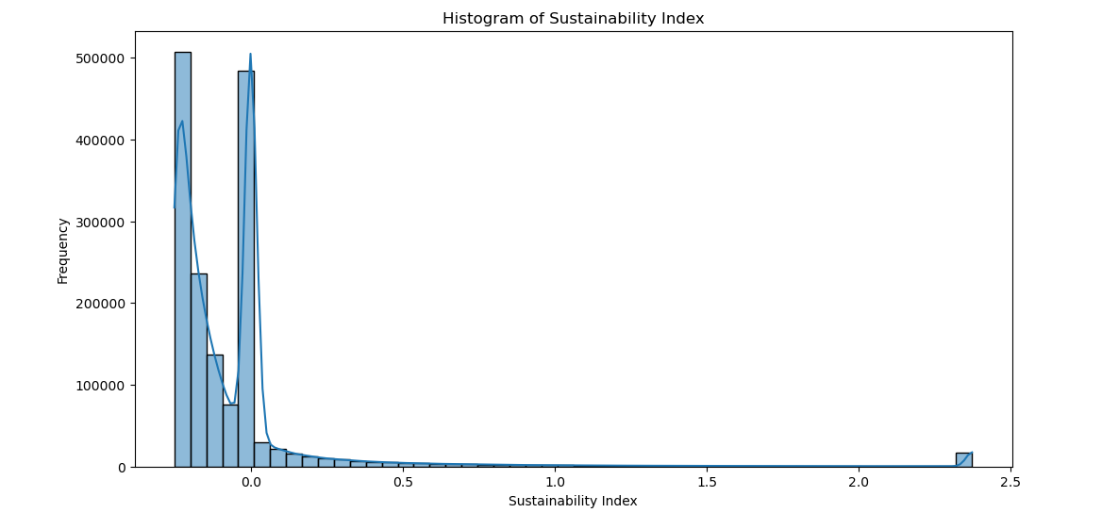
Sustainability Index Histogram

Slide 11
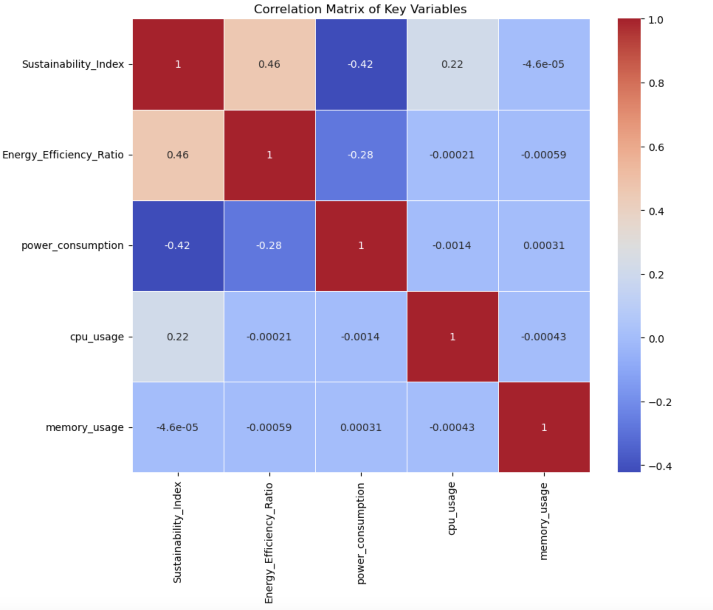
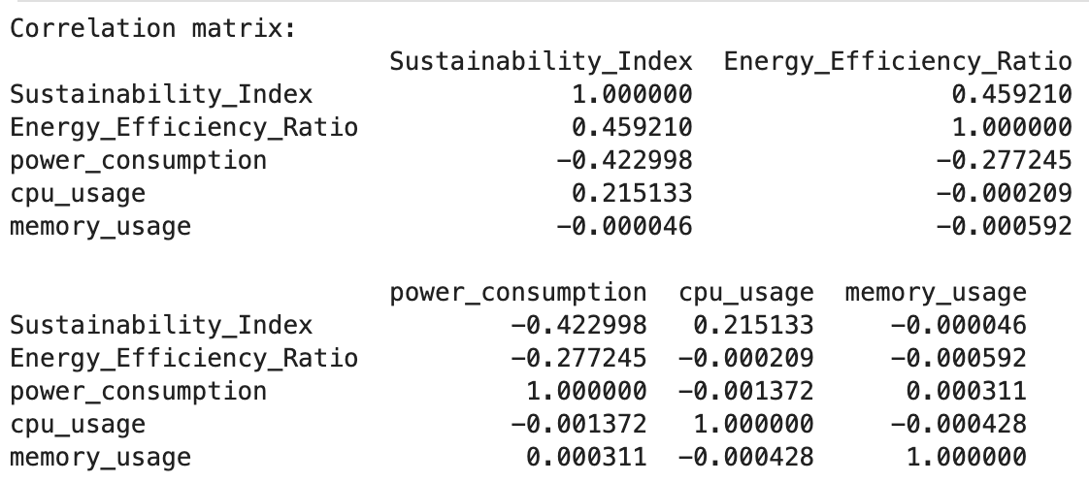
Correlation
Matrix

Slide 12
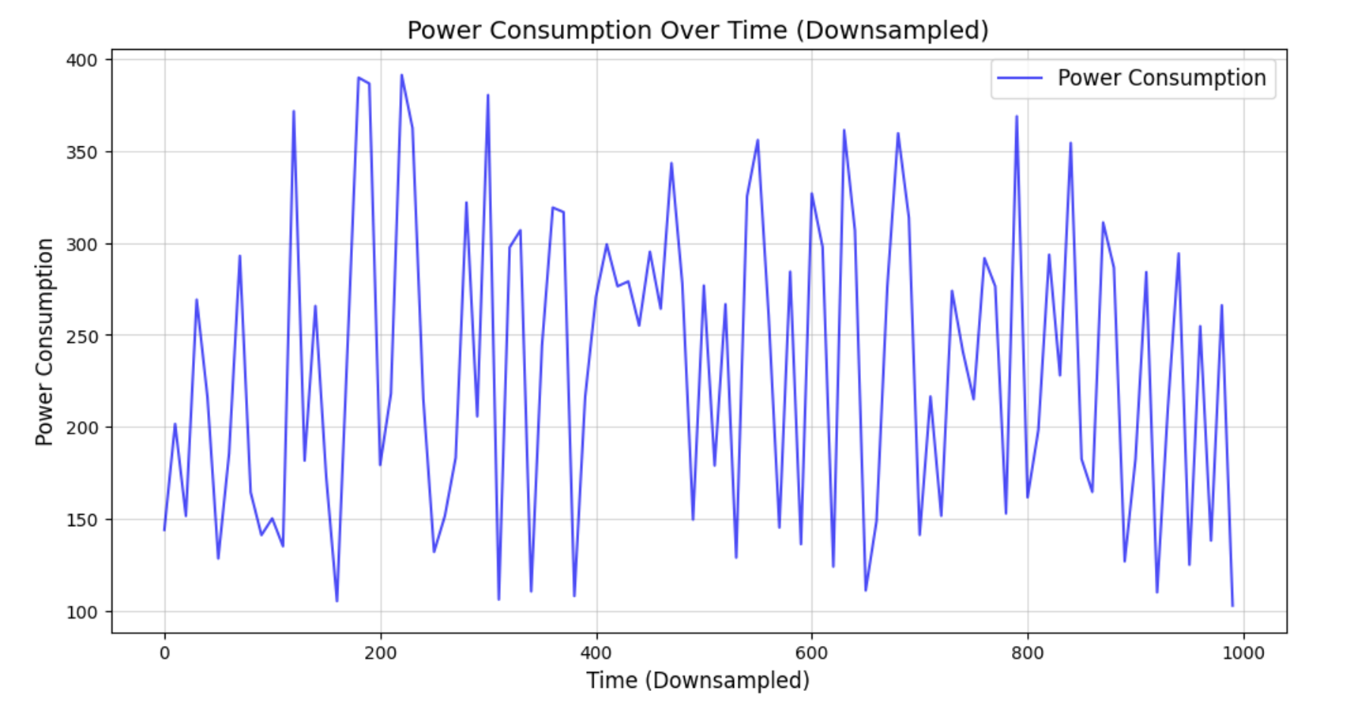
Power consumption over time

Slide 13
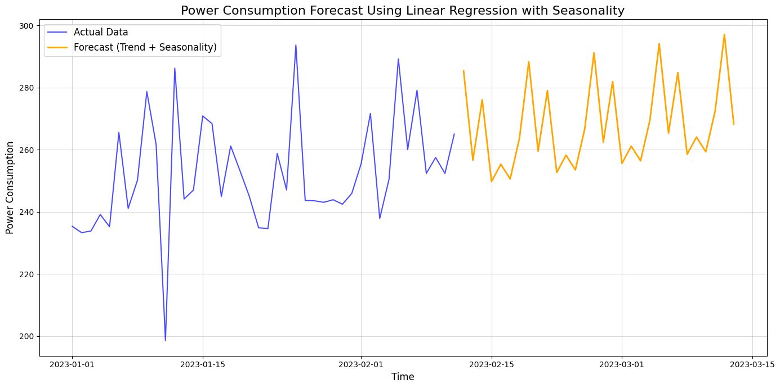
Power Consumption Forecast

Slide 14
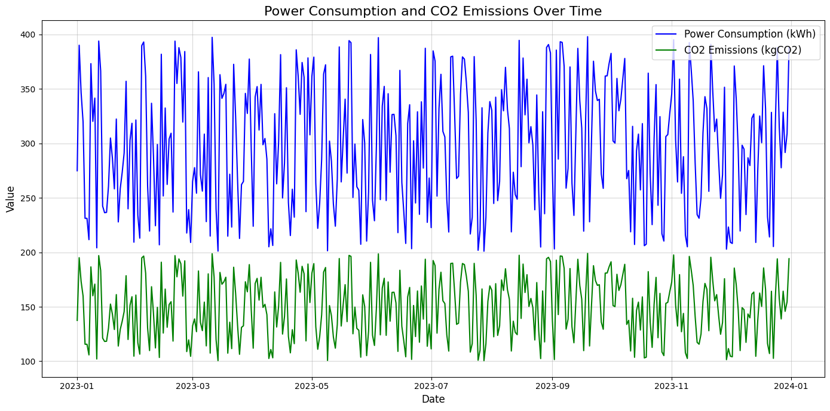
Power Consumption and CO2 Emission over time

Slide 15
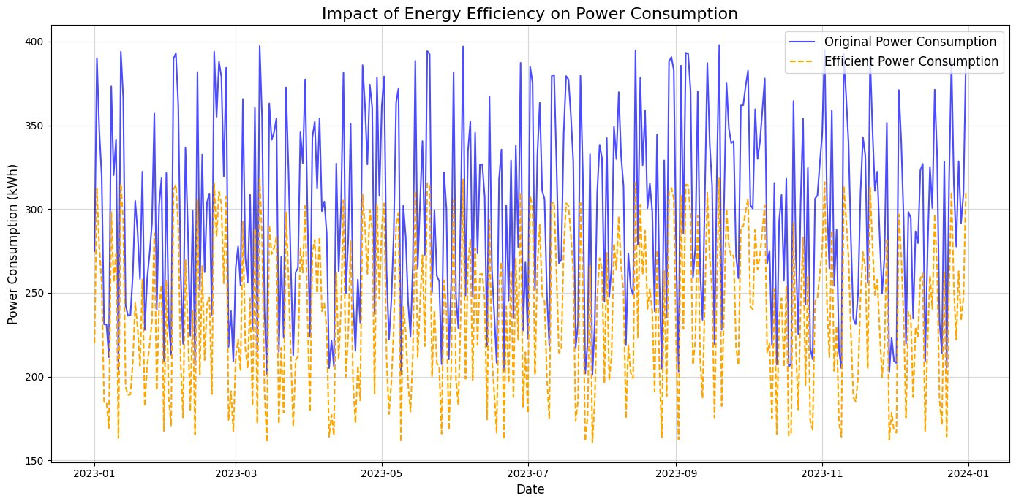
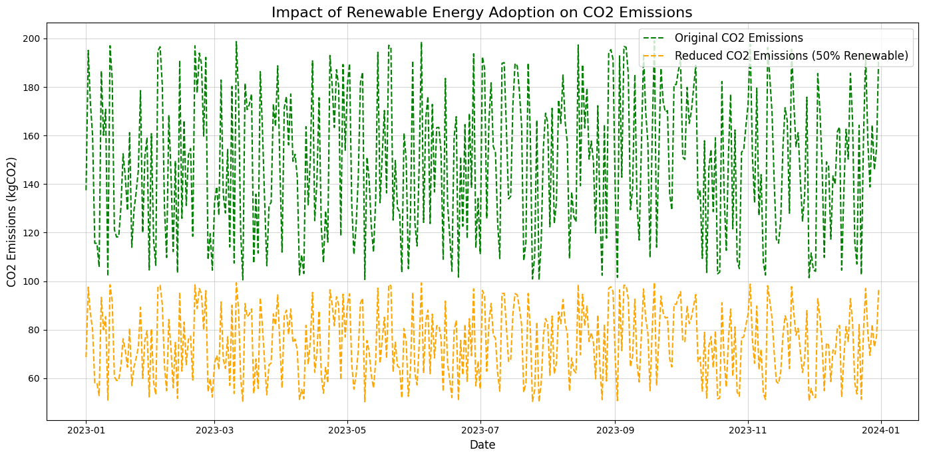
Renewable Energy and CO2 Emission over time

Slide 16
Recommendations
and Conclusion
Energy Savings:
Total energy saved: 21,776.59 kWh, demonstrating the benefits of efficiency measures.
CO₂ Emission Reduction:
Total CO₂ saved: 10,888.29 kgCO₂, highlighting the positive environmental impact.
Key Takeaways:
Implement Energy Efficiency Measures:
Optimize operational processes to lower energy usage.
Use energy-efficient appliances and equipment.
Monitor and Analyze Trends:
Continuously track power consumption and emissions data.
Use predictive models to anticipate and mitigate energy spikes.

Slide 17
THANK YOU

